Slide 1
What’s a Credit Line?!?

Slide 2
Talk with your shoulder partner for 15 seconds about you think a CREDIT LINE is…
Think ART!
GO!

Slide 3
Let’s get a few things straight…
Credit Line- A list of important facts about a work of art
Medium- the material used to make art (media is plural)

Slide 4
Parts of a Credit Line
Name: of the artist
Title: of the work. This always appears in italics.
Year: the work was created.
Medium: used by the artist. It will say mixed media if more than one where used.
Size: of the work. 1st number is always the height, 2nd is the width, and 3D the 3rd is the depth.
Location: of the work.

Slide 5
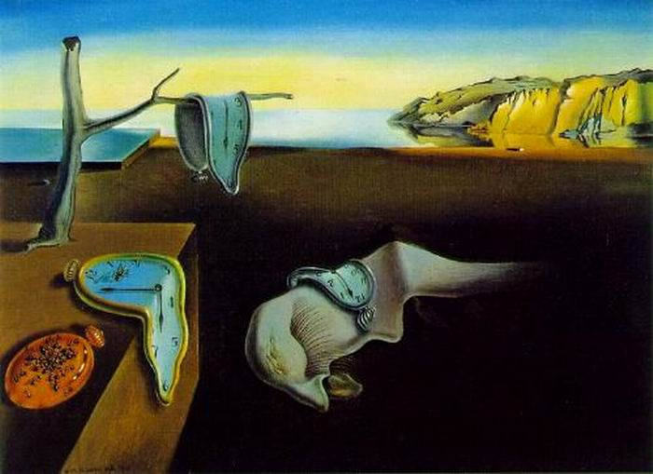
Name?
Title?
Year?
Medium?
Size?
Location?

Slide 6

Salvador Dali, The Persistence of Memory, 1931. Oil on Canvas, 9 ½” x 13” (24 x 33 cm). The Museum of Modern Art, New York.

Slide 7
Your turn!
Each table will need one piece of notebook paper and a person to record…
Number your paper 1-7
Write down what you think the credit line would be for each artwork as it is passed around…

Slide 8
Don’t Forget:
Name
Title
Year
Medium
Size
Location

Slide 9


Slide 10
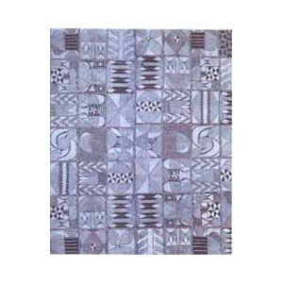
1. Artist Unknown, Adire Cloth, 1804. Cotton
and Indigo, 75” x 69 ¼”. High Museum of Art,
Atlanta, Georgia.

Slide 11

Not the exact image. Sorry.
2. Yoruba People, Ritual Dress Element, 19th Century.
Cloth, glass beads, cord, 19 ½” x 21 ¾”.
Tambaran Gallery, New York.

Slide 12

3. Hans Hofmann, Song of the Nightingale, 1964. Oil
on Canvas, 84” x 72”. Private Collection, New York.

Slide 13

4. Syd Mead, illustration for proposed t.v. series LA2015, 1987. Gouche on illustration board, 20” x 30”.

Slide 14
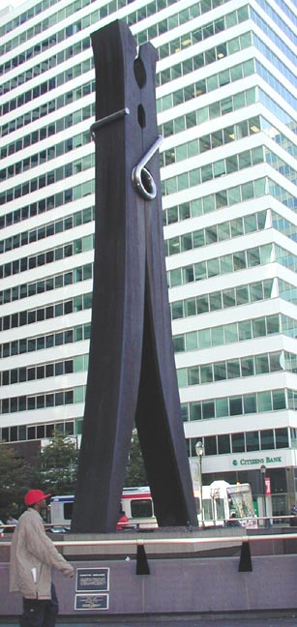
5. Claes Oldenburg and Coosje
van Bruggen, Clothespin,
1976. Painted steel and
stainless steel, 45’ x 12’ 3 ¼”.
Centre Square, Philadelphia.

Slide 15
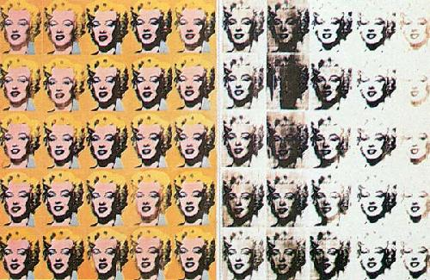
6. Andy Warhol, Marilyn Monroe, 1962. Silk Screen Print, 205 cm x 145 cm. Tate Gallery, London.

Slide 16
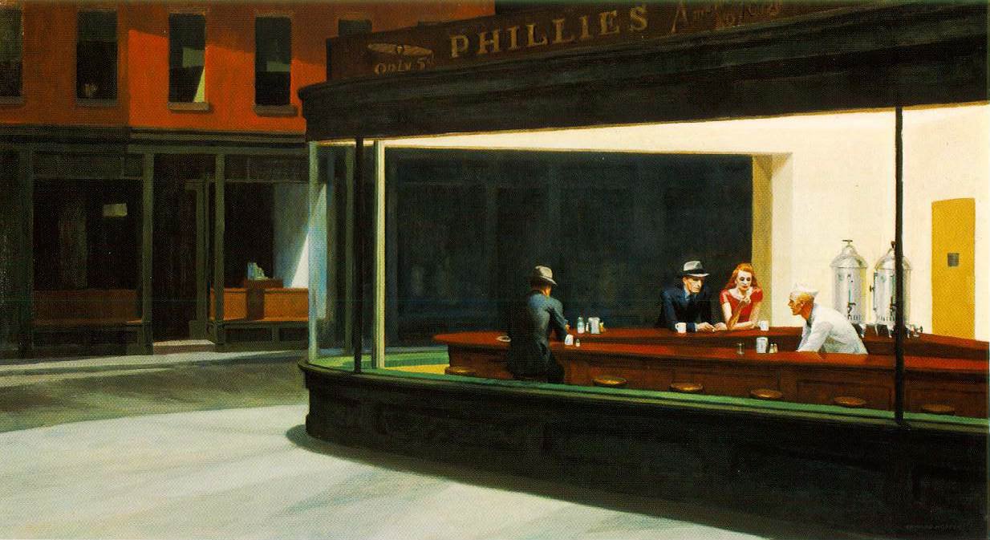
7. Edward Hopper, Nighthawks, 1942. Oil on canvas, 30” x 60”. The Art Institute of Chicago.

Slide 17
Reminders…
If time, begin the Elements of Art practice worksheet.
Wednesday we will begin our next project, so you must have your supplies here by then!!!

